Slide 1


SRI SHAKTHI INSTITUTE OF ENGINEERING AND
TECHNOLOGY
(ANAUTONOMOUS INSTITUTION)
DEPARTMENT OF COMPUTER SCIENCE AND ENGINEERING (CYBER SECURITY) MINI PROJECT
TITLE : Zero Trust DevSecOps Framework for Secure Cloud Deployment
DOMAIN : DEVSECOPS
PRESENTED BY,
TEAM NUMBER: 7
ANISHA S (714023149007)
GUIDED BY,
Ms.N.SRITHEJAS
INDUJA R (714023149031)
KANISHKA R (714023149036)
KEERTHANA R (714023149041) LOHITH M L (714023149050) B.E-CSE (CYBERSECURITY)
ASSISTANT PROFESSOR
CSE (CYBERSECURITY)
SRI SHAKTHI INSTITUTE OF ENGINEERING AND TECHNOLOGY

Slide 2
ZERO TRUST DEVSECOPS FRAMEWORK FOR SECURE CLOUD DEPLOYMENT

Slide 3
PROBLEM STATEMENT
CI/CD pipelines are issued temporary AWS credentials with fixed time-based expiry (e.g., 1 hour), regardless of how long the actual task takes — creating an unnecessary exposure window if the credential leaks Access decisions are made purely on identity, without considering whether the target deployment environment is currently vulnerable or secure.
When a leaked/stolen credential is reused, existing systems simply deny access, giving security teams no visibility into who the attacker is or what they were after
Core problem: There is no unified system that combines completion-based credential revocation, vulnerability-aware access decisions, and active deception against misuse in a single CI/CD pipeline security framework.

Slide 4
ABSTRACT
Modern CI/CD pipelines rely on static, time-based access credentials to deploy code to cloud infrastructure a model that leaves a dangerous "leftover access window" even after a task is complete. This project proposes a Zero Trust DevSecOps framework that grants pipeline stages temporary, least-privilege AWS credentials, gated by real-time vulnerability posture (VAPT) checks and revoked instantly upon task completion rather than a fixed timer.
Misuse of stolen or expired credentials is met not with a simple block, but with a honeytoken-based deception mechanism that traps and logs attacker behavior. The system integrates Jenkins, Terraform, AWS IAM/STS/CloudTrail, OpenVAS, and Prometheus/Grafana to deliver a working, measurable reduction in credential exposure time compared to conventional static-TTL approaches.

Slide 5
PROPOSED METHODOLOGY
Define per-stage access requirements as YAML intent manifests
Provision scoped AWS IAM roles and infrastructure via Terraform
Integrate automated VAPT scanning (OpenVAS/Nikto) as a pre-access gate
Build a Python-based access engine (boto3) that issues AWS STS temporary credentials matching the
manifest
Monitor real-time API activity via AWS CloudTrail, comparing actions against the declared manifest
1.Zero Trust Core
2.VAPT Gate
3.Deception Layer
Trigger immediate credential revocation on task completion or scope violation
Implement a honeytoken layer (AWS Lambda + EventBridge) to intercept and log misuse attempts
Visualize credential lifecycle, scan results, and security events via Prometheus + Grafana
Benchmark exposure window (time credentials remain valid post-task) against a static-TTL baseline

Slide 6
IMPLEMENTATION
Define access requirements using a YAML intent manifest.
Provision AWS infrastructure using Terraform.
Create least-privilege IAM roles and policies for deployment access.
Perform a pre-access VAPT/security check using a Python-based scanner.
Generate temporary AWS credentials using AWS STS through Boto3.
Restrict deployment access to the permissions declared in the YAML manifest.
Test authorized and unauthorized S3 operations to verify least privilege.
Enable AWS CloudTrail to record AWS API activity.
Monitor cloud activity against the declared access scope.
Trigger access revocation after the deployment task is completed.
Apply an explicit-deny IAM policy to block the deployment role's S3 access.
Implement a honeytoken prototype to record simulated credential misuse.
Store access and honeytoken events in local JSON files.
Develop a Streamlit dashboard to visualize access, VAPT, CloudTrail, revocation, and honeytoken status.
Validate the complete workflow through an end-to-end AWS demonstration.

Slide 7
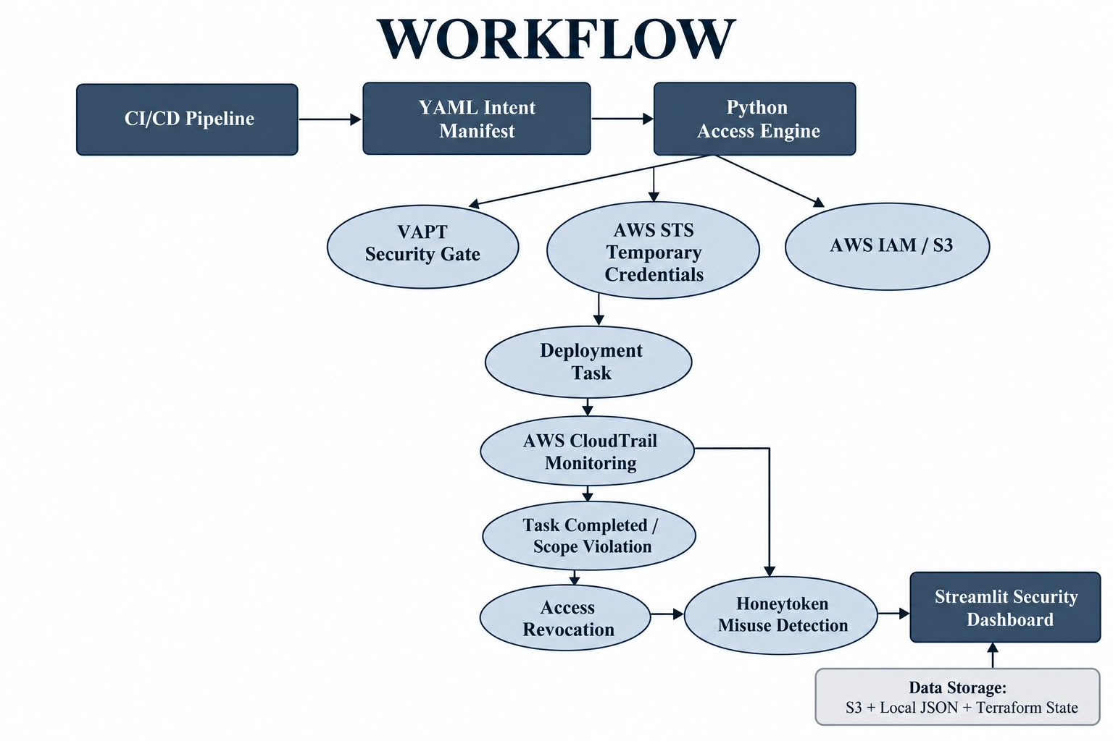
WORKFLOW

Slide 8
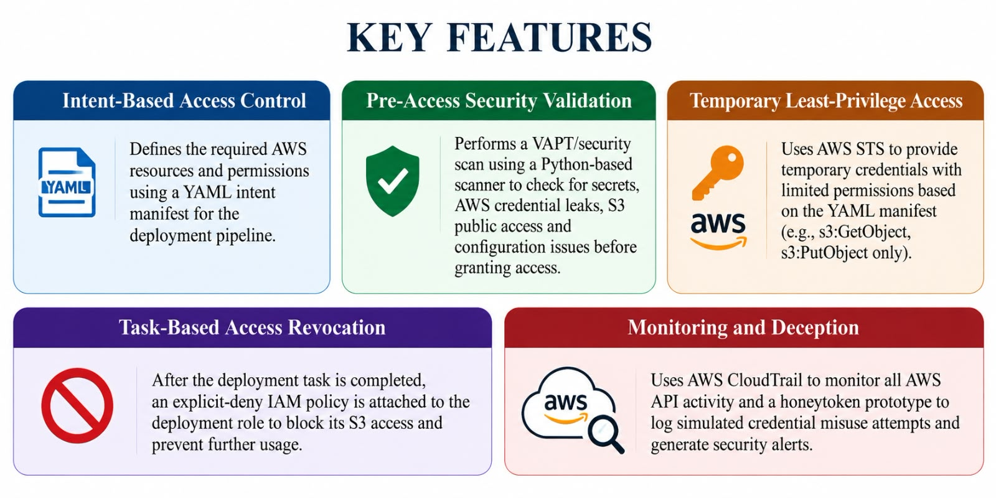
KEY FEATURE

Slide 9
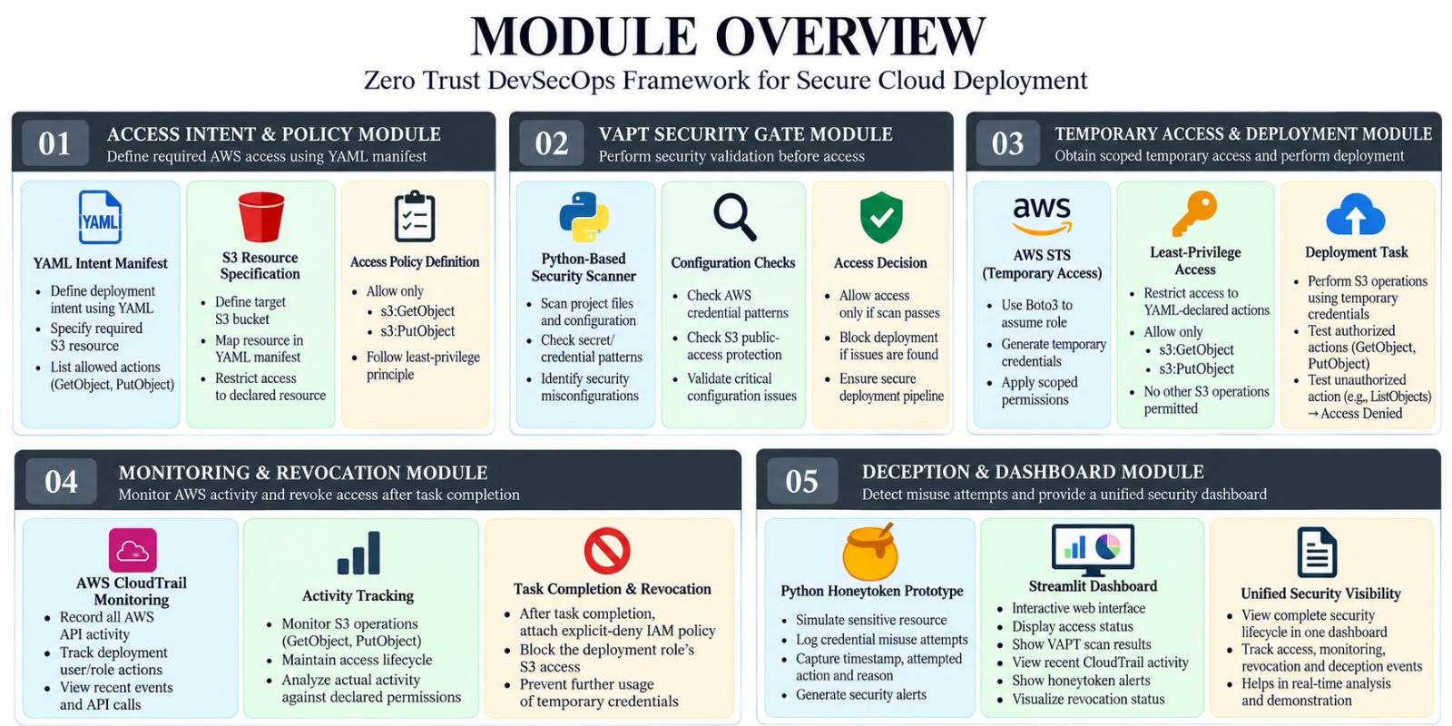
KEY FEATURE

Slide 10

TECH STACK
LAYER | TOOL
CI/CD Pipeline | Jenkins
Cloud Platform | AWS (Free Tier)
Infrastructure as Code Terraform Temporary Credentials | AWS STS
Access Policy | AWS IAM
Activity Logging | AWS CloudTrail
VAPT Scanning | OpenVAS / Nikto
Core Logic | Python (boto3)
Deception Trigger AWS | Lambda + EventBridge
Monitoring | Prometheus + Grafana
Attack Simulation | Kali linux VM
Manifest Format | YAML

Slide 11
EXISTING
Uses Zero Trust Architecture for secure communication.
Focuses mainly on microservices communication.
Uses OIDC and OAuth 2.0 for user authentication and authorization.
Uses SPIFFE/SPIRE to provide secure identities to services.
Uses Istio Service Mesh to enforce secure communication and mTLS.
Uses Open Policy Agent (OPA) for centralized policy-based authorization.
Uses short-lived security tokens to reduce long-term credential exposure.
Monitors service communication and security activities through telemetry and audit logs.
Uses GitOps for managing security policies.
Evaluates security using metrics such as token replay, unauthorized access, latency, and throughput.
Mainly addresses service-to-service and user-to-service access in microservices environments.
Does not explicitly include a pre-access VAPT gate or honeytoken-based deception layer.

Slide 12
REFERENCES
Establishing Workload Identity For Zero Trust CI/CD: From Secrets to SPIFFE-Based Authentication
Zero Trust Security Model Implementation in Microservices Architecture using Identity Federation

